Slide 1
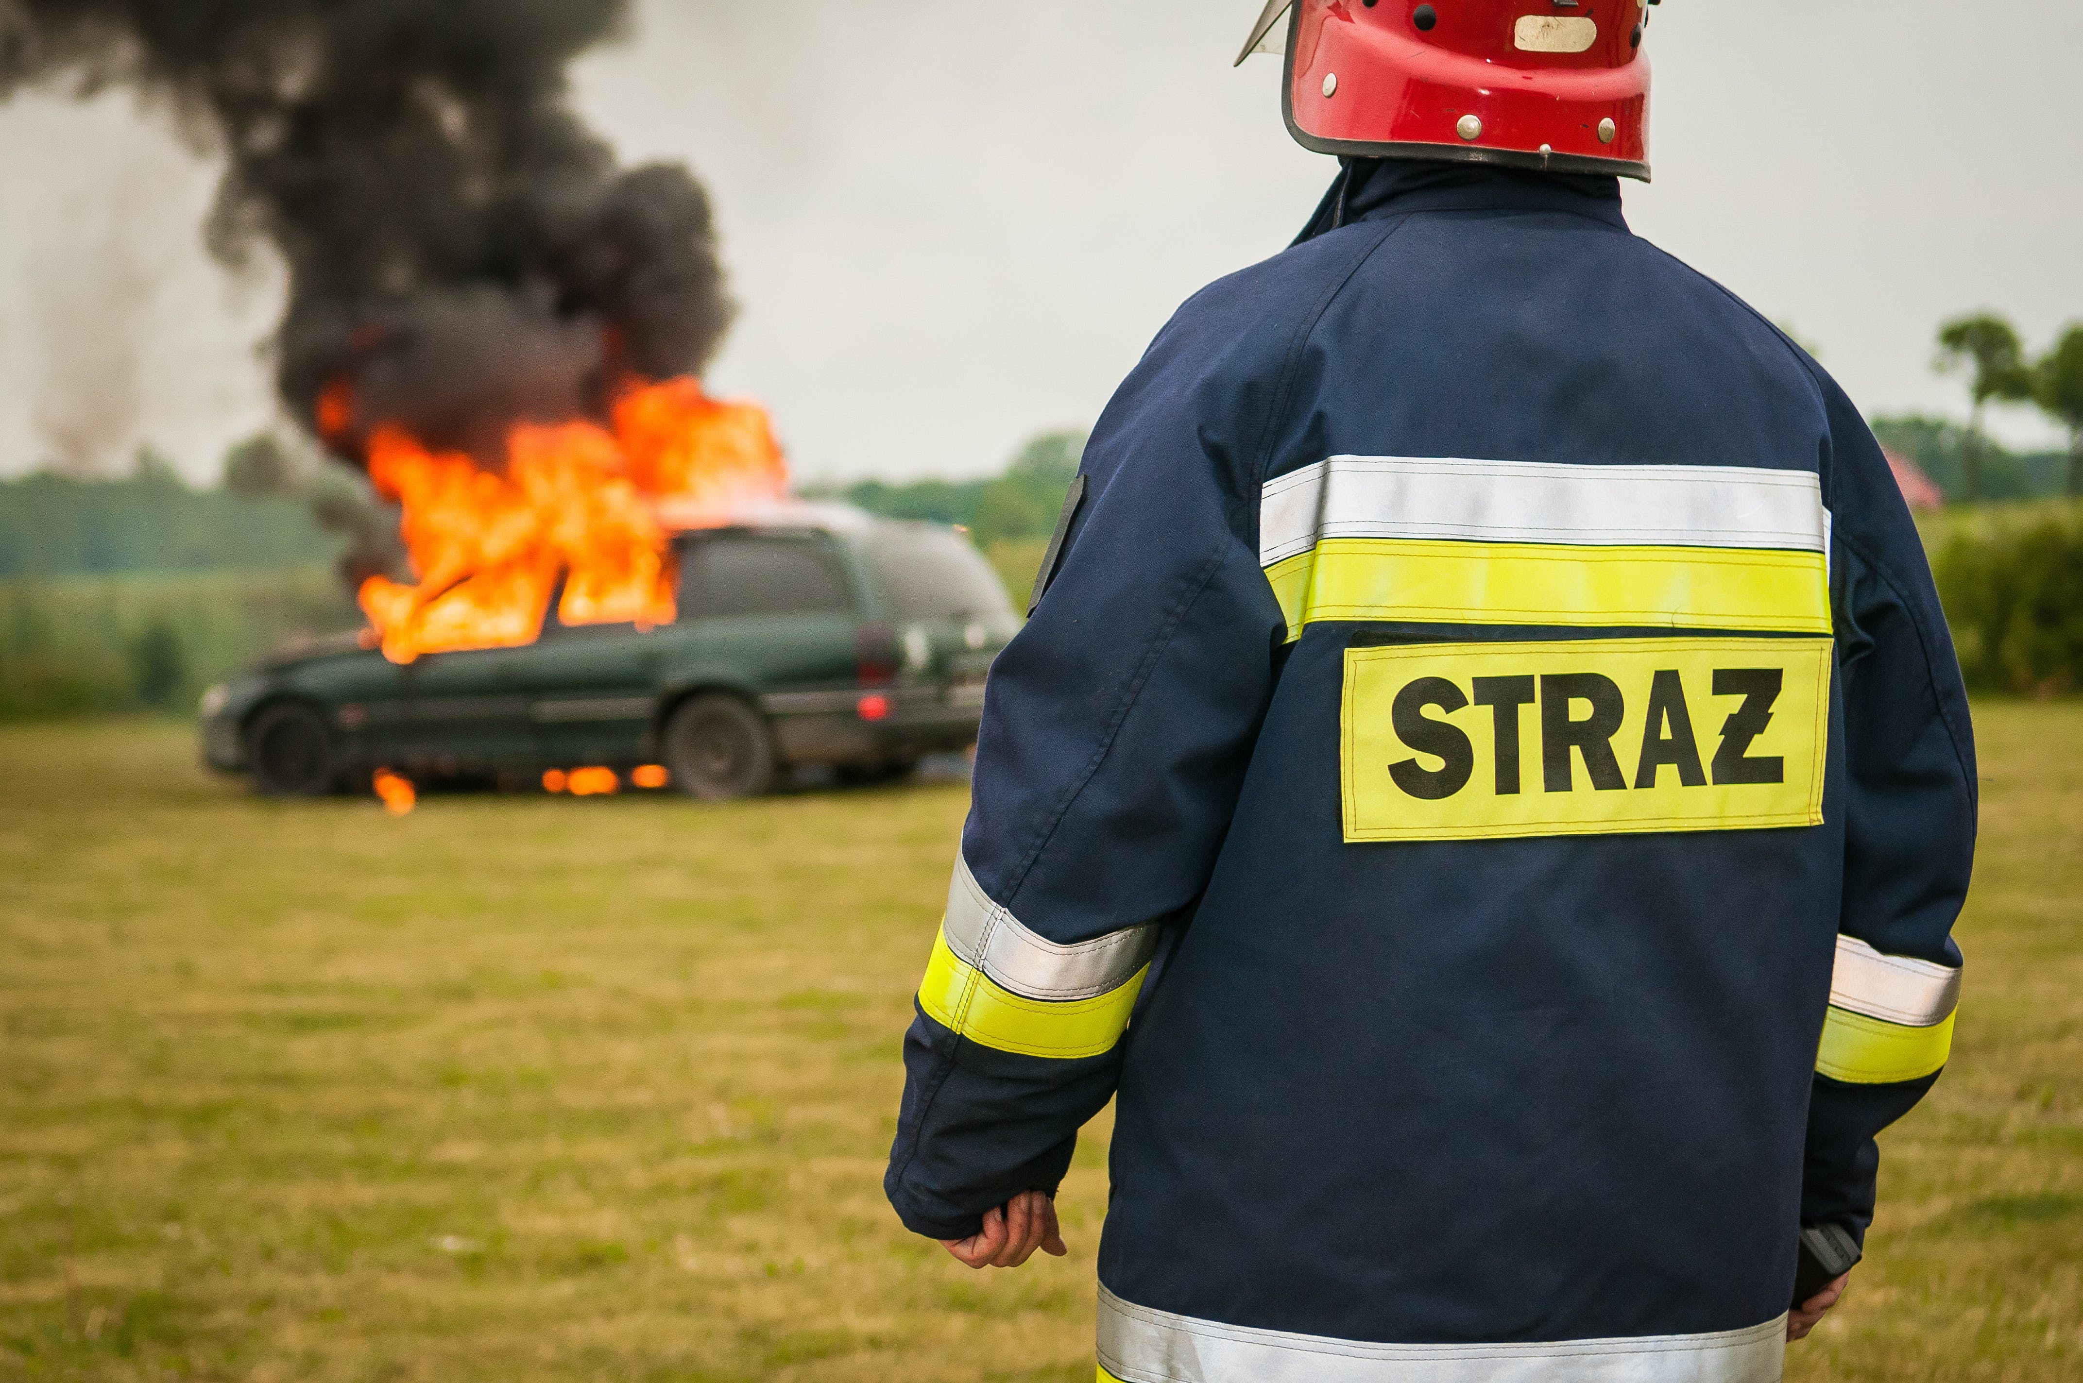
PHASE III
CHICAGO CAR CRASHES
GROUP SEVENTEEN
Caroline Mbugua
Dianna Wangura
Eunita Kolusi
Mark Kuria
Mlati Ochieng'
Rhoda Musyoki

Slide 2

INTRODUCTION
DATASETS:
We fetched crash data from E-Crash showing information about each traffic crash on city streets within the City of Chicago limits and under the jurisdiction of Chicago Police Department (CPD). Data is shown as is from the electronic crash reporting system (E-Crash) at CPD, excluding any personally identifiable information. Records are added to the data portal when a crash report is finalized or when amendments are made to an existing report in E-Crash.
Traffic Crashes- Vehicle
Traffic Crashes- People
Traffic Crashes- Crashes

Slide 3
CONTENTS:
2. Business understanding
1. Addressing Research Questions
3. Findings
5. Visualizations
4. Conclusion and Recommendations

Slide 4

01
Addressing Research Questions
Does lack of traffic control device influence accidents and injuries?
In which weather conditions do most injuries and accidents occur?
Does the number of years since manufacture of a car influence the accidents?
In most accidents and injuries occuring do they relate to a certain age group of drivers?

Slide 5
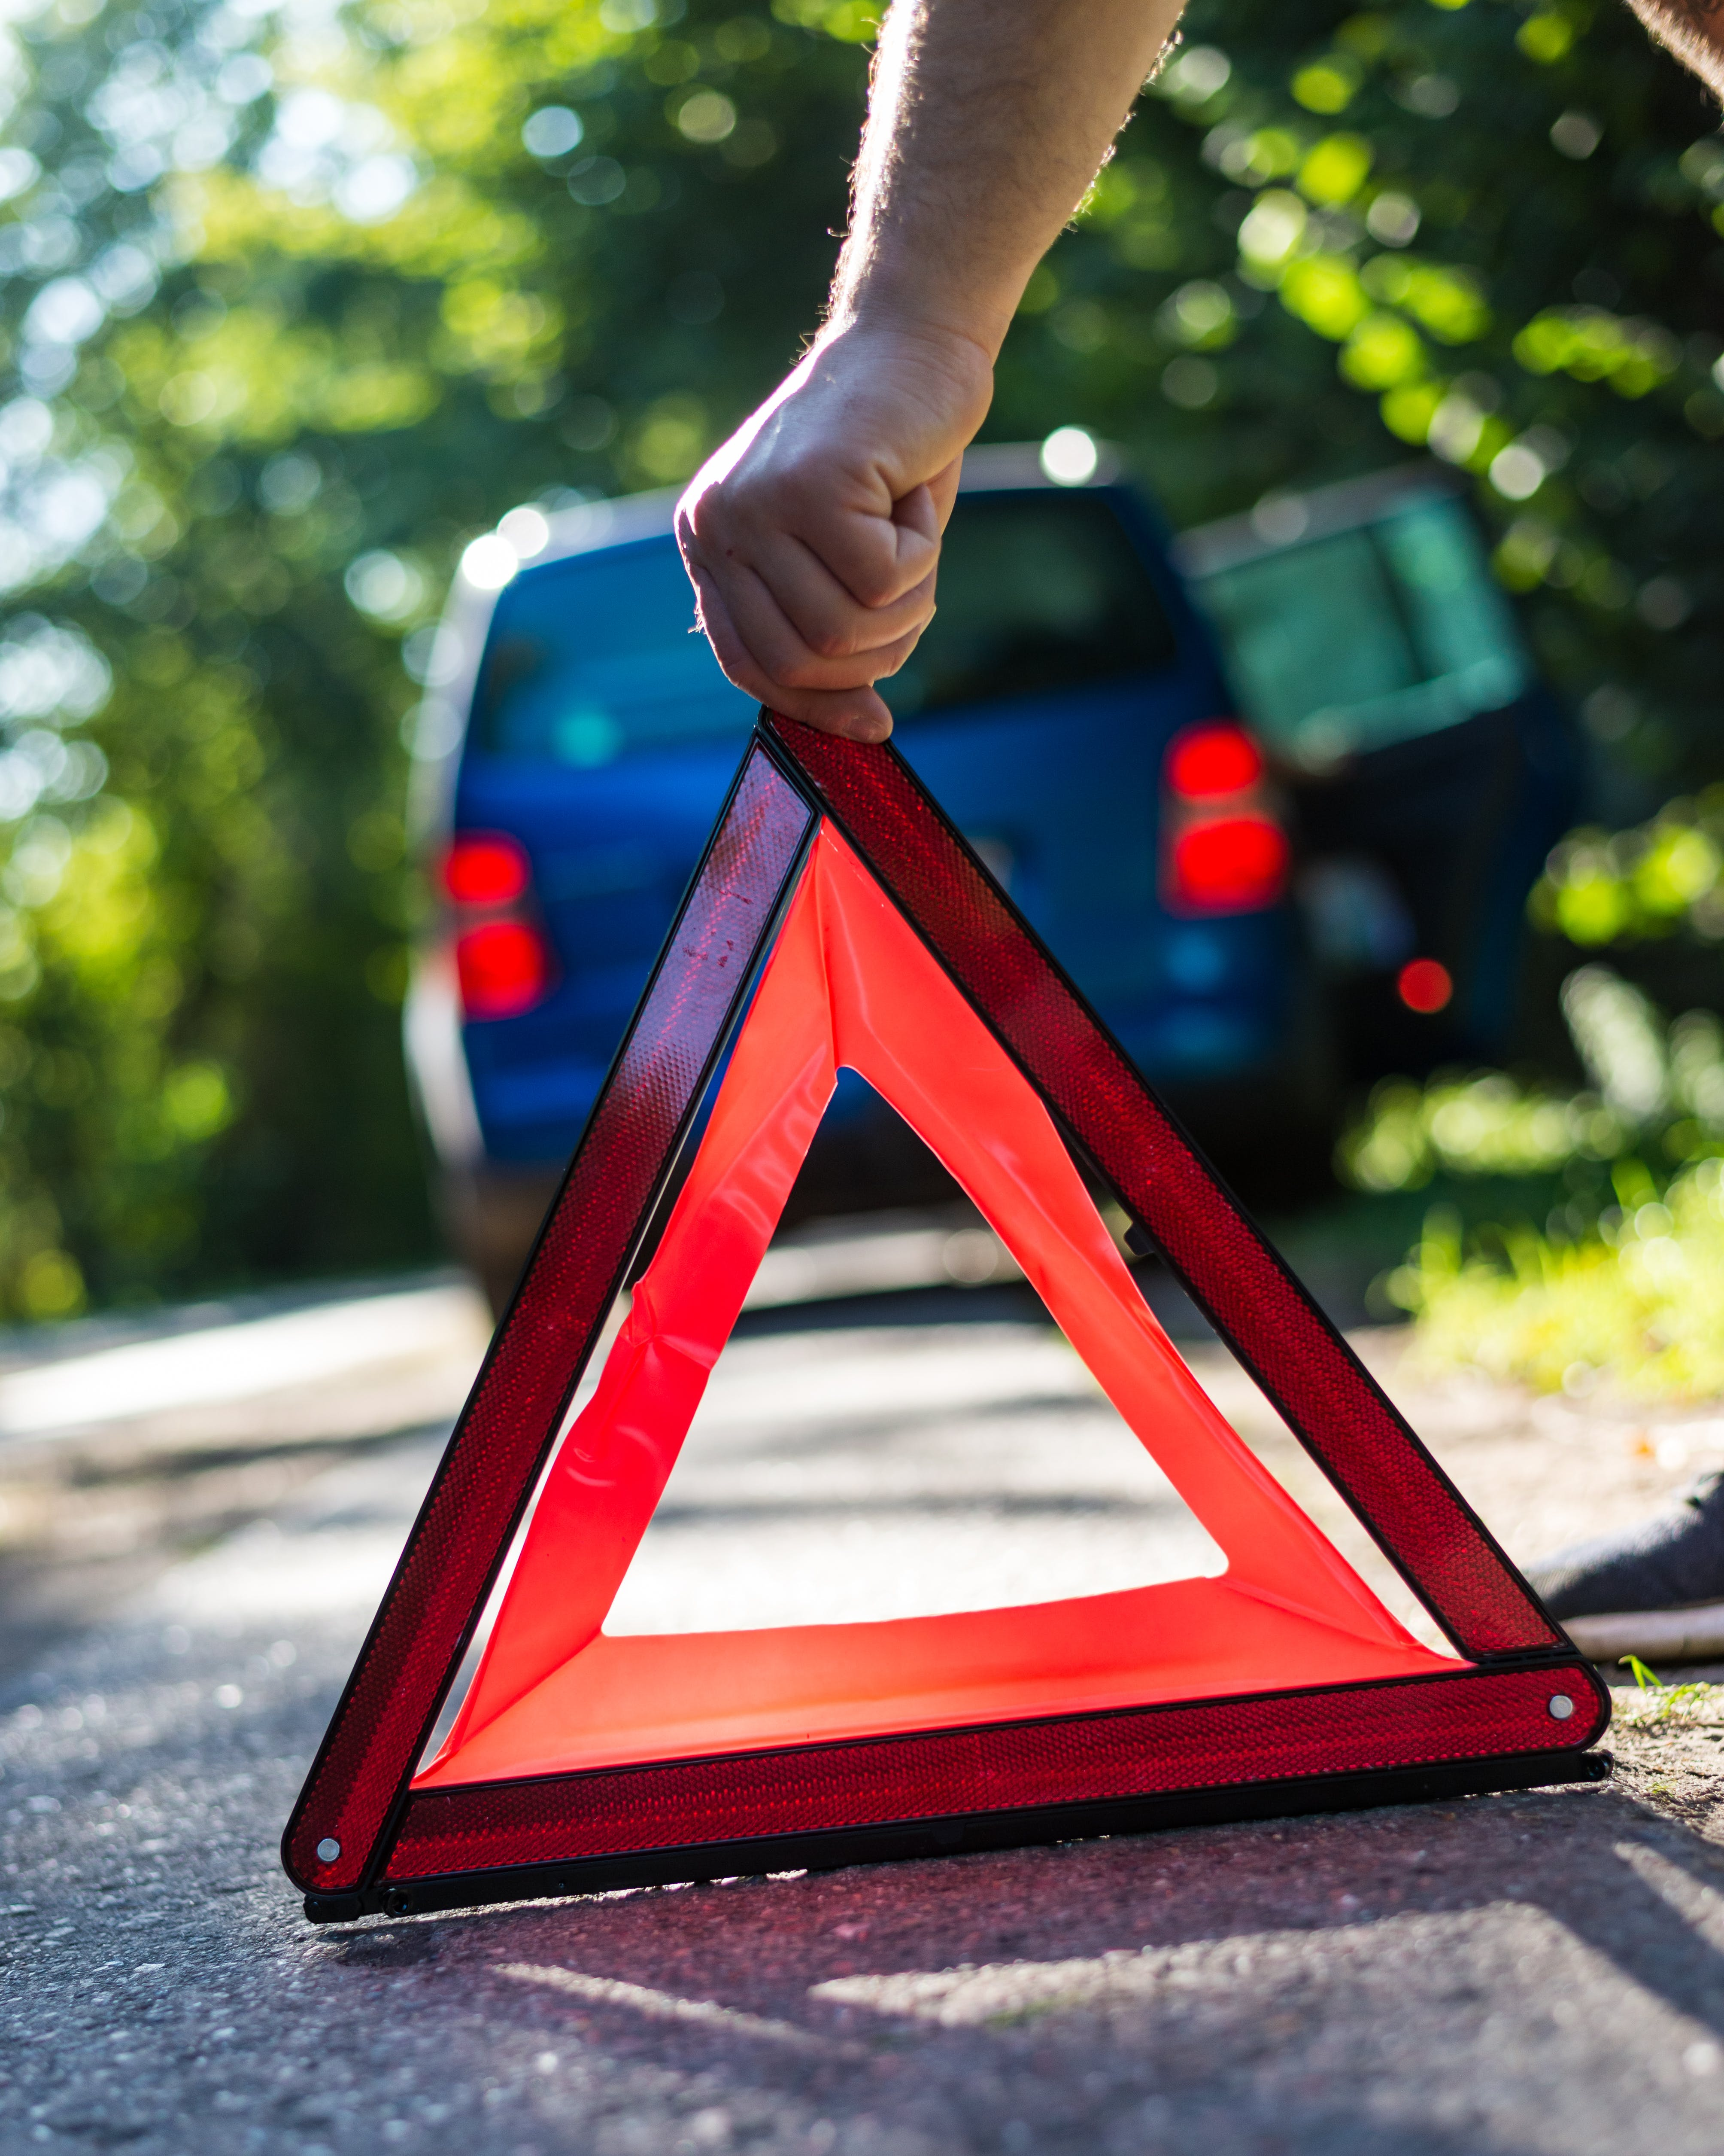
02
Business Understanding
Business understanding involves gaining a comprehensive understanding of the campaign's goals, objectives, and the broader context of the initiative. Here are key components of the business understanding:

Slide 6
Problem Statement: The city of chicago main goal is to be able to come up withsolutions to help end or reduce number of accidents. The city of chicago seeks to develop a predictive model that will help indentify the major causes of accidents
Problem statements
Stakeholder: The primary stakeholder in this scenario is the Vehicle Safety Board of Chicago. They are launching a new campaign with the goal of reducing car crashes in the city.
Buiness problem: Build a classifier to predict the primary contributory cause of a car accident, given information about the car, the people in the car, the road conditions etc.
Stakeholder
Business Problem

Slide 7
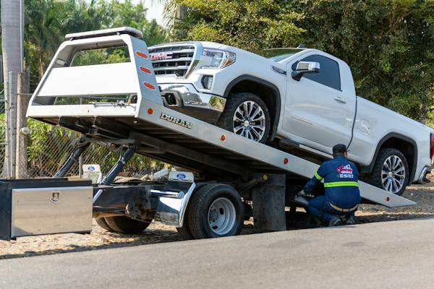
04
Conclusion and Recommendations
The following are our recommendations ;
The city to put restrictions on vehicles allowed in roads to be below ten years
The city lowers the speed limit during afternoon/rush hour or more patrol in the 30-40 mph zones.
The city should increase the traffic control devices to reduce in accidents occurences

Slide 8
Recommendations:
The following are our recommendations ;
The city to put restrictions on vehicles allowed in roads to be below ten years
The city lowers the speed limit during afternoon/rush hour or more patrol in the 30-40 mph zones.
The city should increase the traffic control devices to reduce in accidents occurences

Slide 9

05
Visualizations
To visualize this we will use 4 diagrams we extracted from the several in the notebook

Slide 10
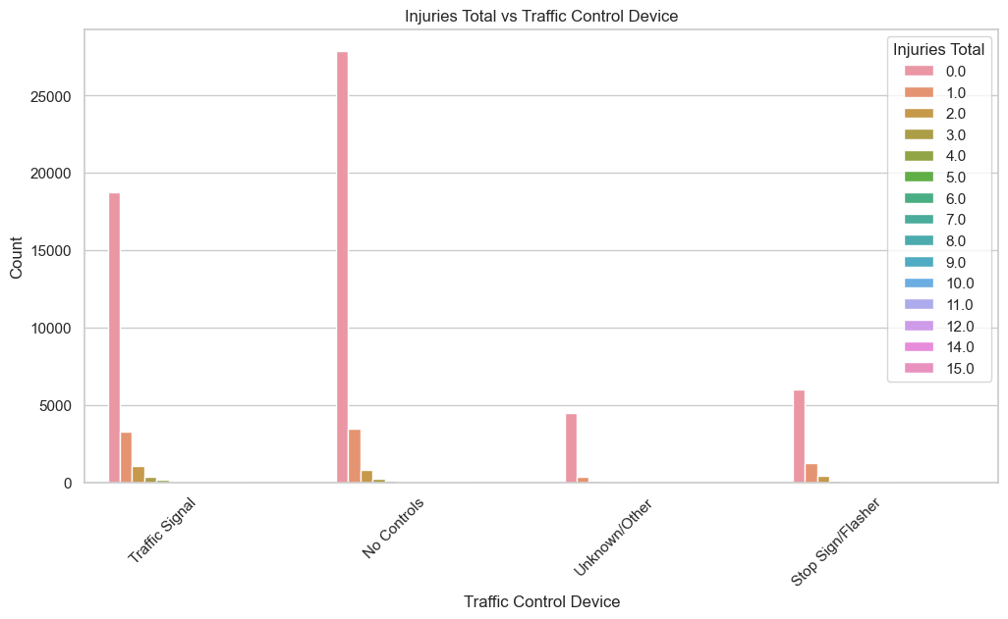
INJURIES TOTAL vs TRAFFIC CONTROL DEVICE

Slide 11
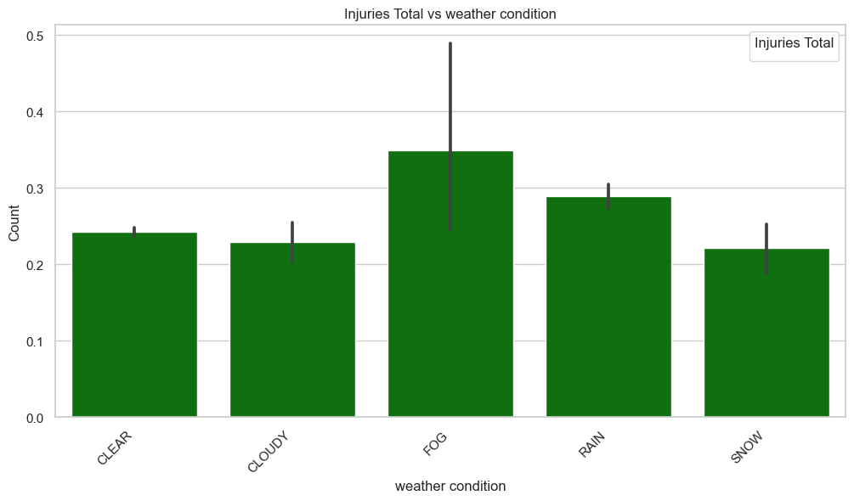
INJURIES TOTAL vs WEATHER CONDITION

Slide 12
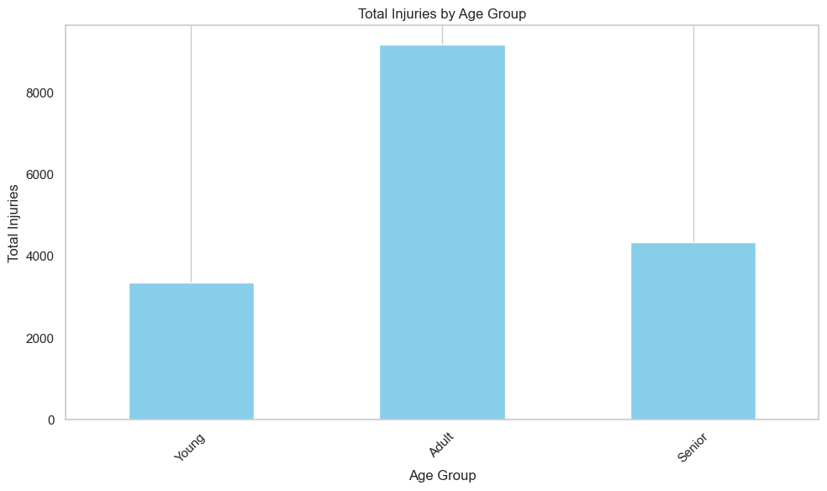
TOTAL INJURIES BY AGE GROUP

Slide 13
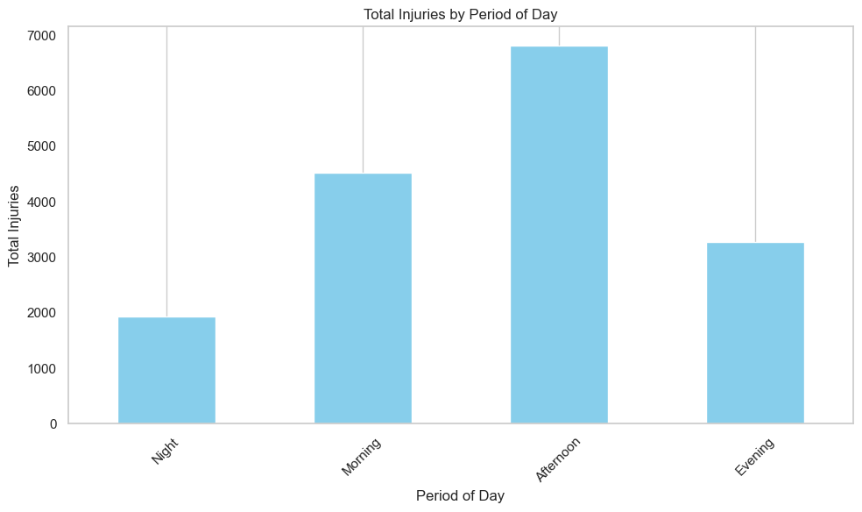
TOTAL INJURIES BY PERIOD OF DAY

Slide 14
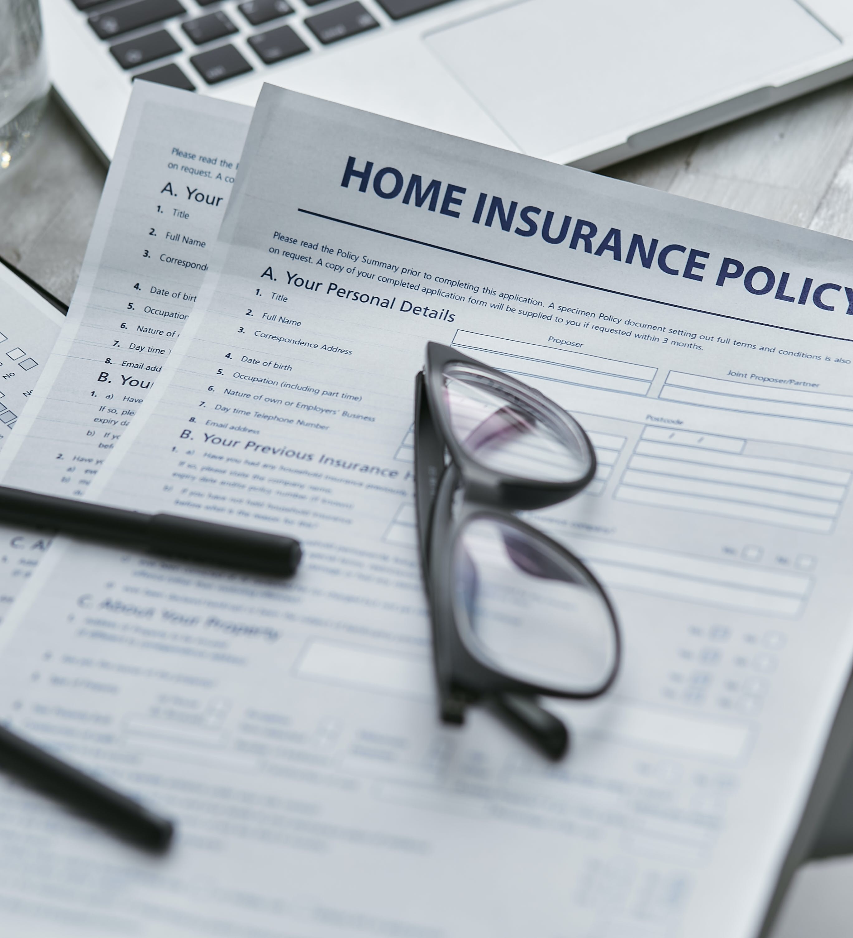
03
Findings and Conclusions
Most of the injuries recorded were caused by drivers between the age of 25 to 50 years falling into the adult category
Based on the data, it shows that most accidents occur in the afternoon/rush hour.
It also shows that most accidents occur in speed limit zones labeled between 30-40 mph.
Most of the vehicles involved in the accidents fell into the old category that is they were in the road for a period of more than ten years
Most of the accidents occured where there were no traffic signals but less injuries were observed

Slide 15
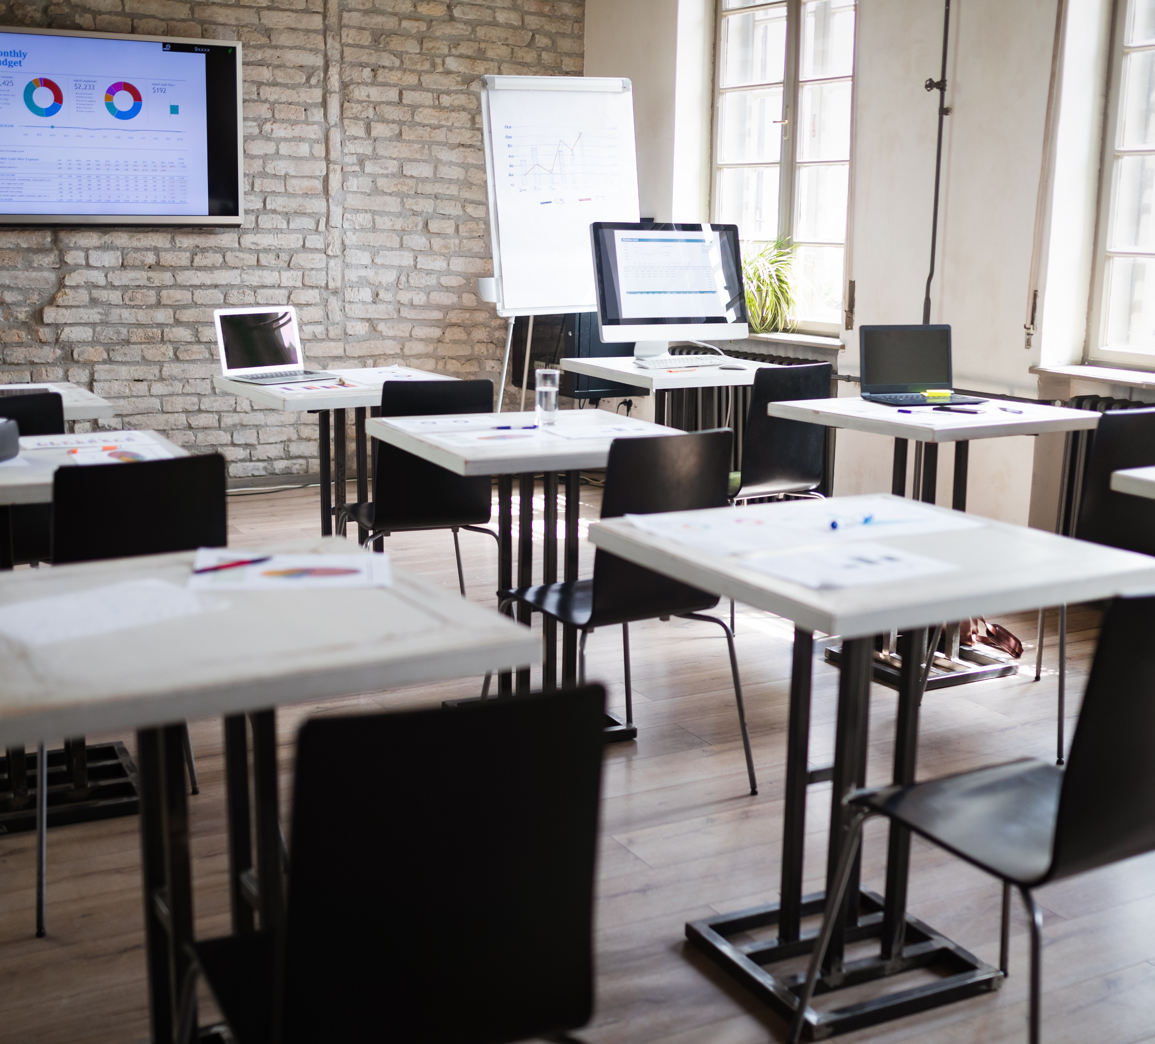
THANK
YOU
Project: Chicago Car Crashes
Group: 17

